Slide 1
COMS E6998: Microservices and Cloud Applications Lecture 5: API Management, API GW, Step Functions, OAuth2
Dr. Donald F. Ferguson
dff9@columbia.edu

Slide 2
Questions? Comments? (Pagination)

Slide 3
Development Methodology Design Docs Project Submission Requirements

Slide 4
Agile Development
Traditional “Waterfall” Methodology
Design seems to be missing?

Slide 5
Observations
Weinberg's Second Law: “If builders built buildings the way programmers wrote programs, then the first woodpecker that came along would destroy civilization.”
Sr. Celestina: “If you cannot write it down, you do not understand it.”
“it is a custom More honor'd in the breach than the observance” Hamlet Act 1, scene 4, 7–16
Agile Manifesto (http://agilemanifesto.org/):
Individuals and interactions over processes and tools
Working software over comprehensive documentation
Customer collaboration over contract negotiation
Responding to change over following a plan
Also, I want to help you build your “soft skills.”
Presentations
Elevator Speeches.
Project demos/reviews.

Slide 6
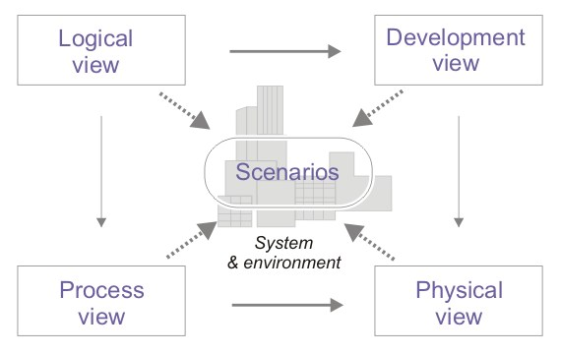
4+1 architectural view model http://en.wikipedia.org/wiki/4%2B1_architectural_view_model

Slide 7
The Architecture Views http://en.wikipedia.org/wiki/4%2B1_architectural_view_model
Logical view : The logical view is concerned with the functionality that the system provides to end-users. UML Diagrams used to represent the logical view include Class diagram, Communication diagram, Sequence diagram.^{[2]}
Development view : The development view illustrates a system from a programmer's perspective and is concerned with software management. This view is also known as the implementation view. It uses the UML Component diagram to describe system components. UML Diagrams used to represent the development view include the Package diagram.^{[2]}
Process view : The process view deals with the dynamic aspects of the system, explains the system processes and how they communicate, and focuses on the runtime behavior of the system. The process view addresses concurrency, distribution, integrators, performance, and scalability, etc. UML Diagrams to represent process view include the Activity diagram.^{[2]}
Physical view : The physical view depicts the system from a system engineer's point of view. It is concerned with the topology of software components on the physical layer, as well as the physical connections between these components. This view is also known as the deployment view. UML Diagrams used to represent physical view include the Deployment diagram.^{[2]}
Scenarios : The description of an architecture is illustrated using a small set of use cases, or scenarios which become a fifth view. The scenarios describe sequences of interactions between objects, and between processes. They are used to identify architectural elements and to illustrate and validate the architecture design. They also serve as a starting point for tests of an architecture prototype. This view is also known as use case view

Slide 8
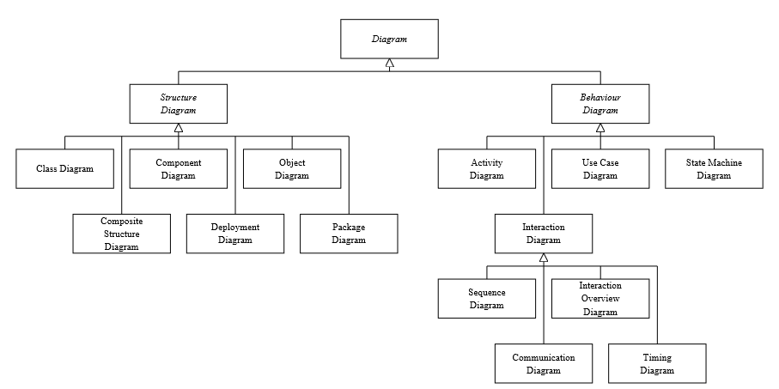
Some Diagrams http://www.agilemodeling.com/essays/umlDiagrams.htm

Slide 9
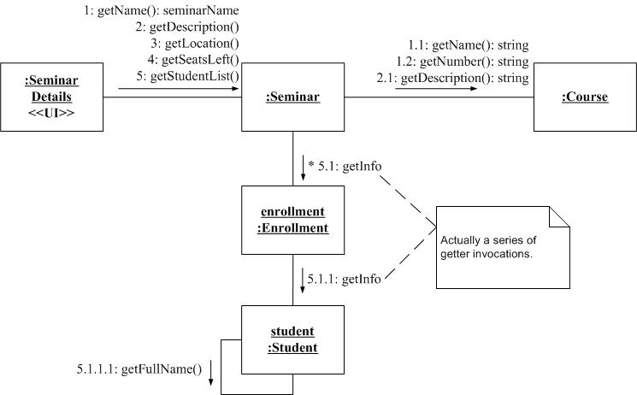
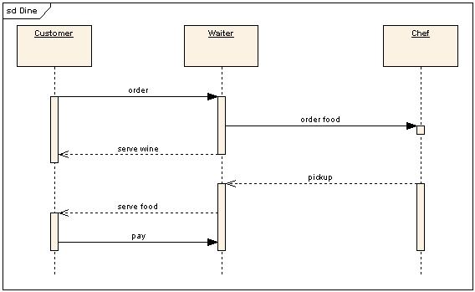
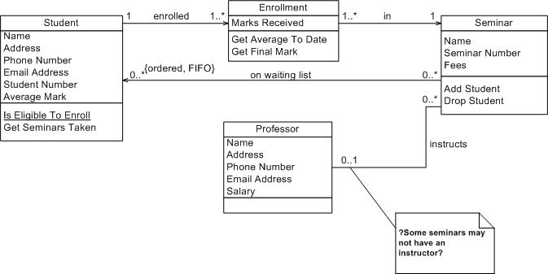
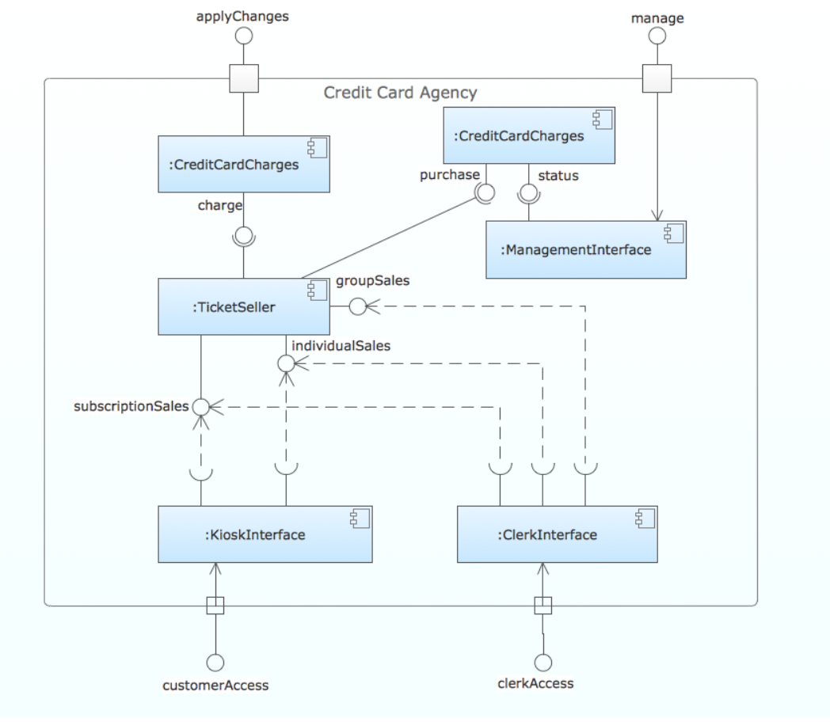
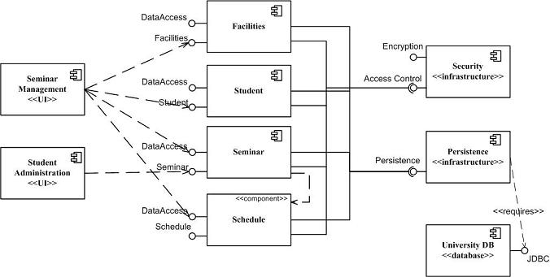
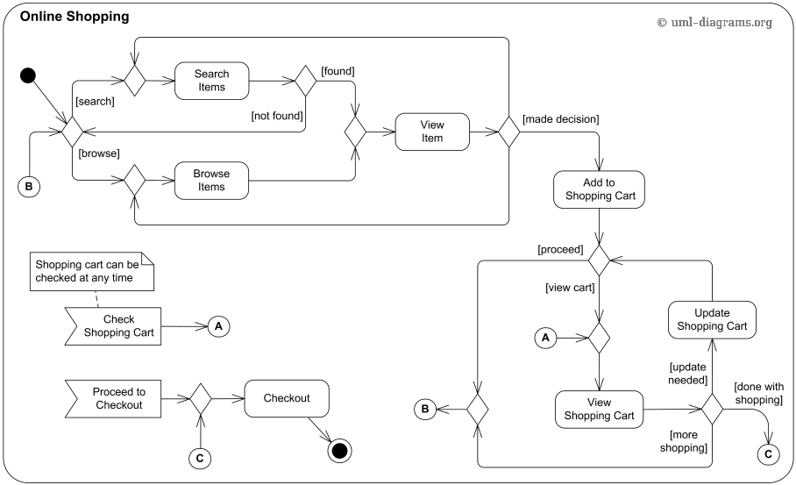
Some Diagrams
Communication Diagram
Class Diagram
Sequence Diagram
Component Diagram
Component Diagram
Activity Diagram

Slide 10
Application to Project Submissions
Communication Diagram
Class Diagram
Sequence Diagram
Component Diagram
Component Diagram
Activity Diagram

Slide 11
User Stories
User stories are short, simple descriptions of a feature told from the perspective of the person who desires the new capability, usually a user or customer of the system. They typically follow a simple template: (https://www.mountaingoatsoftware.com/agile/user-stories)
As a <type of user>, I want <some goal> so that <some reason>.
Example user stories (http://www.agilemodeling.com/artifacts/userStory.htm)
Students can purchase monthly parking passes online.
Parking passes can be paid via credit cards.
Parking passes can be paid via PayPal.
Professors can input student marks.
Students can obtain their current seminar schedule.
Students can order official transcripts.
Students can only enroll in seminars for which they have prerequisites.
Transcripts will be available online via a standard browser

Slide 12
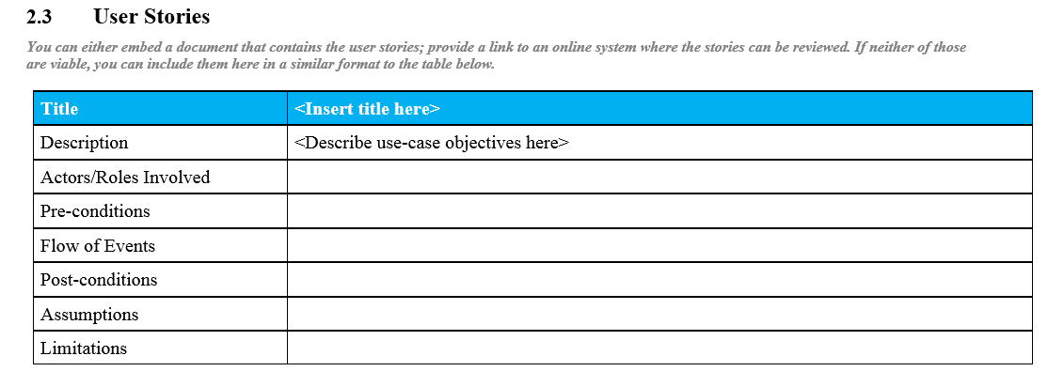
Agile Development and User Stories

Slide 13
Documenting API Example (We will use Swagger and Swagger Editor)
URI | https://mysite.com:3911/api/members/{id}
HTTP verb | PUT
Parameters | id : Card number of the member.
Body | name : Name of the member. email : Email adress of the member. langage : Langage used by member (Fr_CA ou En_US)
Sample body | { "name":"Mario Cardinal", "email":“mcardinal@mariocardinal.com", "language":"fr_CA" }
Success Response | Status Code: 204 No Content
Error Response | Status Code: 400 Bad Request, Body: {"Error Code":"..."} Status Code: 401 Unauthenticated, see WWW-Authenticate value in header Status Code: 403 Forbidden Status Code: 404 Not Found Status Code: 429 Too Many Requests, see Retry-After value in header Status Code: 500 Internal Server Error Status Code: 503 Service Unavailable
Error Code | 10: Inactive member 20: Denied access member 110: Database issues, Retry later

Slide 14
Documenting API Example (We will use Swagger and Swagger Editor)
URI | https://mysite.com:3911/api/members/{id}
HTTP verb | PUT
Parameters | id : Card number of the member.
Body | name : Name of the member. email : Email adress of the member. langage : Langage used by member (Fr_CA ou En_US)
Sample body | { "name":"Mario Cardinal", "email":“mcardinal@mariocardinal.com", "language":"fr_CA" }
Success Response | Status Code: 204 No Content
Error Response | Status Code: 400 Bad Request, Body: {"Error Code":"..."} Status Code: 401 Unauthenticated, see WWW-Authenticate value in header Status Code: 403 Forbidden Status Code: 404 Not Found Status Code: 429 Too Many Requests, see Retry-After value in header Status Code: 500 Internal Server Error Status Code: 503 Service Unavailable
Error Code | 10: Inactive member 20: Denied access member 110: Database issues, Retry later
Use Swagger to document APIs.

Slide 15
Top-Level Design Specification
Comments
I have presented a very systematic version of TLDS content.
All development projects should do some flavor of this approach, ideally simple and living/dynamic.
Just want to give you a feel for the types of things you can include in your TLDS, but you only need a really simple version.
Use common sense.
For your TLDS
Definitely define, prioritize and implement simple user stories.
You do not need to use UML, but should use some of the concepts.
Some useful diagrams/artifacts
Swagger API document.
Component diagram.
Class diagram documenting the logical datamodels/ resource models for components.
Some sequence diagrams showing end-to-end flows and Lambda functions in flows.
Why am I asking you to do this?
Documenting and presenting user stories, APIs and designs is a crucial career skill.
Learning the basic methodology is essential to converting unclear business requirements into a solution that satisfies both engineering and business stakeholders.
I purposely give you unclear specifications to force you to THINK and apply methodology.
The grade is based on the “correct answer,” but because the request is unclear, you use the methodology to define your correct answer.

Slide 16
API Management API Gateway

Slide 17
API Management

Slide 18
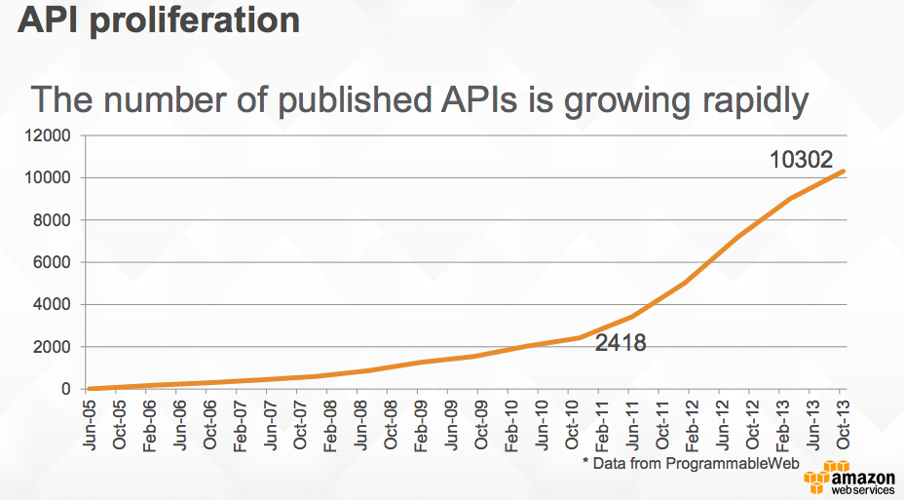
API Proliferation (https://www.slideshare.net/AmazonWebServices/build-and-manage-your-apis-with-amazon-api-gateway)

Slide 19
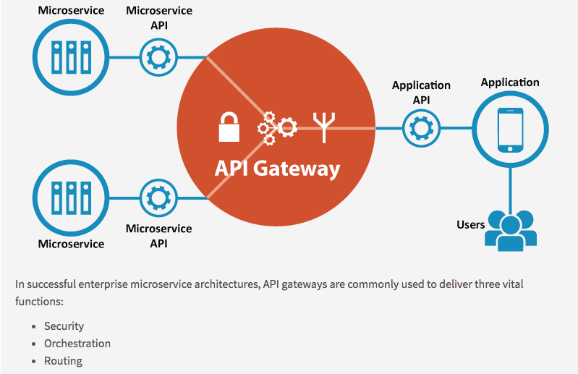
API Gateway/API Management/API Strategy
http://www.apiacademy.co/

Slide 20
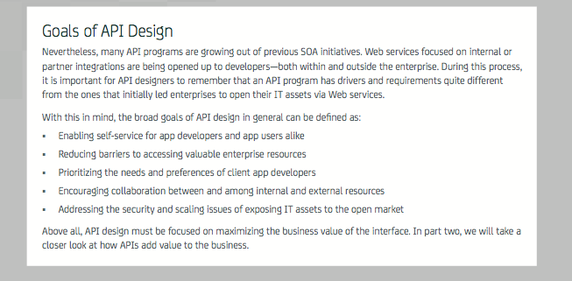
API Design/Strategy (https://www.ca.com/content/dam/ca/us/files/ebook/api-strategy-and-architecture-a-coordinated-approach.pdf)

Slide 21
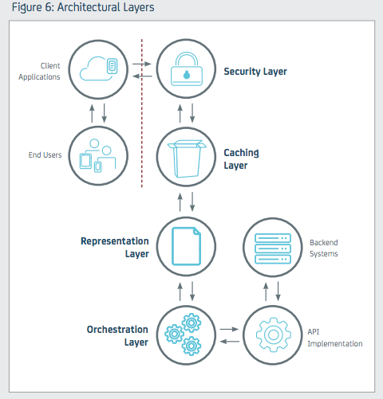
Architecture Layers

Slide 22
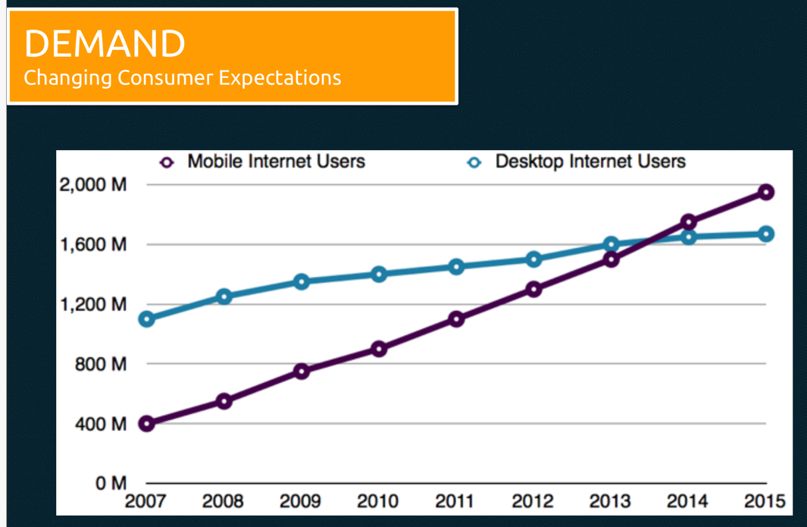
https://www.slideshare.net/mulesoft/welcome-to-the-api-economy-developing-your-api-strategy
Enable apps other than your client to access your APIs and drive business/value.

Slide 23
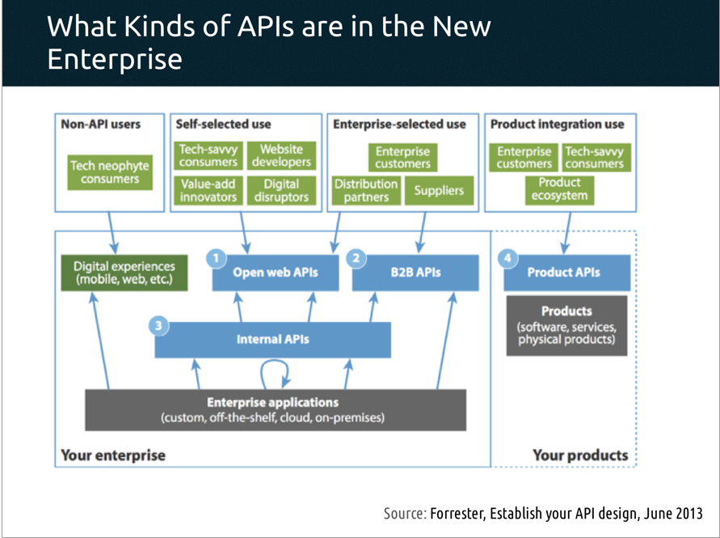

Slide 24
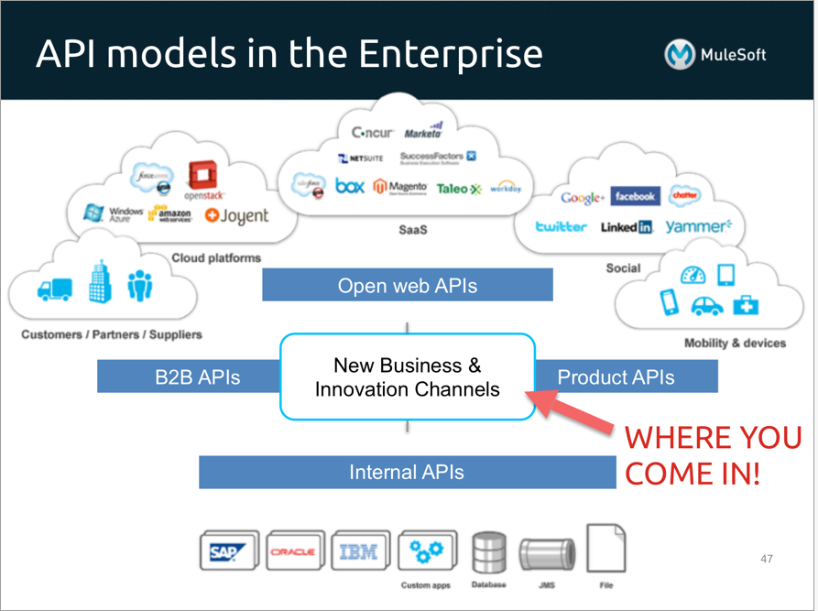
Much of this appears to be independent of the cloud and –as-a-Service, but …
Internal is a statement of ownership, not deployment.
The gateway/boundary
Is logical.
May be a cloud service.
API economy is about
Finding APIs.
Consuming APIs.
Composing APIs.
Publishing APIs.

Slide 25
API Gateway

Slide 26
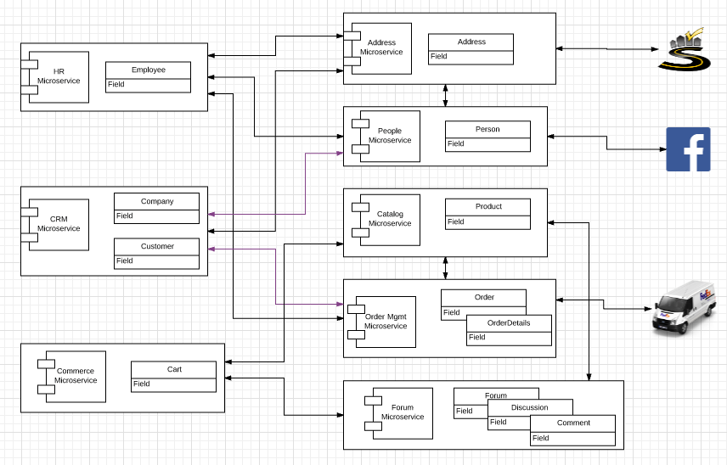
Microservice Model

Slide 27
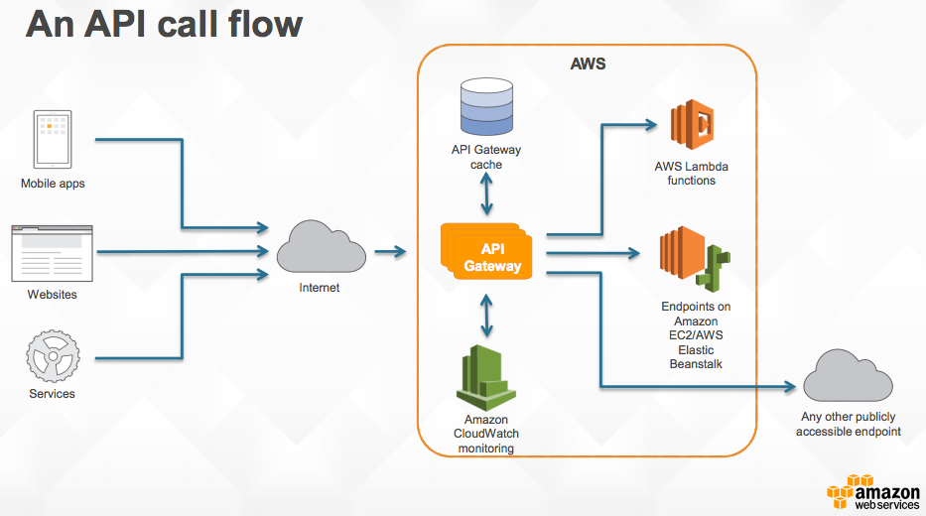
API Gateway

Slide 28
Authorization

Slide 29
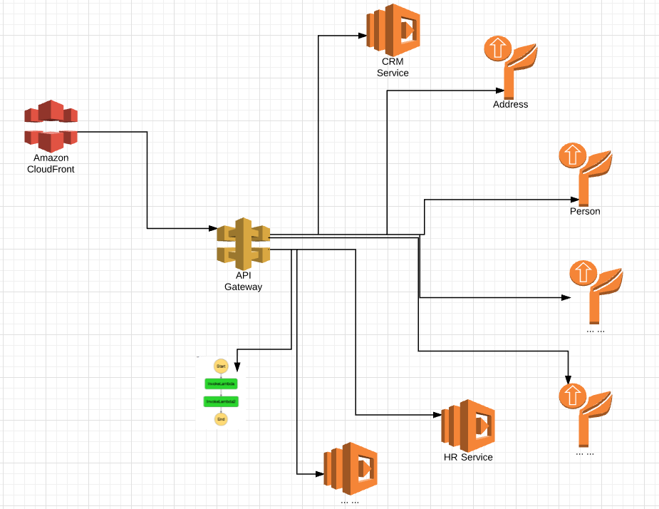
Target Architecture
Microservices will interact “directly” (not shown) via
REST
SNS
SQS
The Lambda functions will
Implement composition microservices in code.
Simulate “complex” applications.
We will add Step Functions to
Implement some complex processes
Understand orchestration engine relative to code implementation.
API Gateway
Implement consistent API.
API Management functions.
Implement authentication and authorization.
CloudFront provides single
Site/domain image.
SSL termination/certificates.

Slide 30
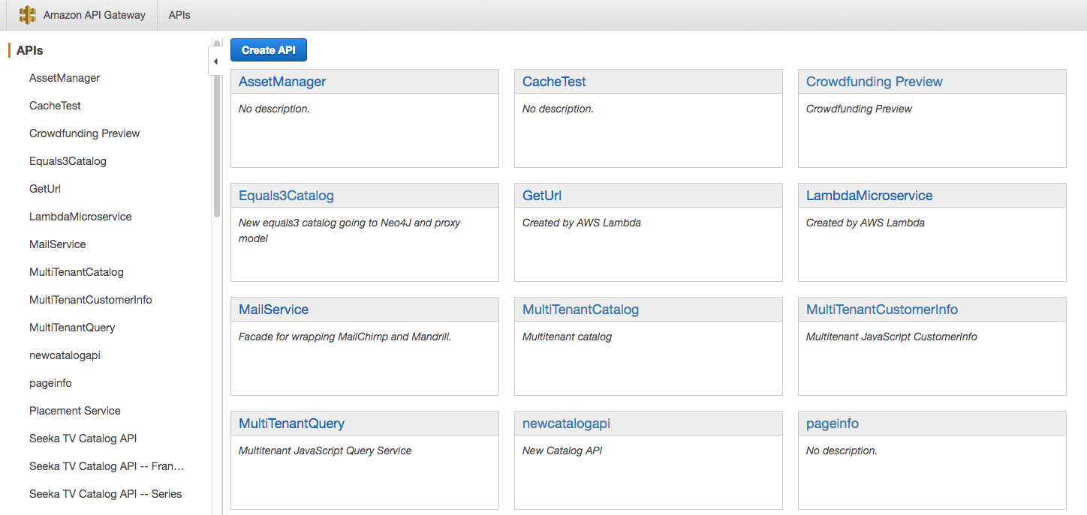
API Gateway/Management

Slide 31
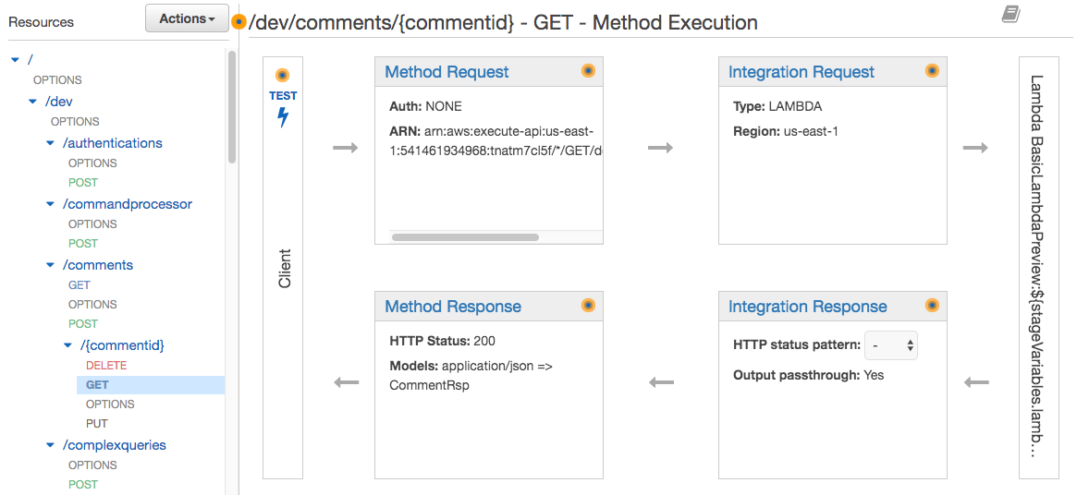
Walkthrough of API

Slide 32
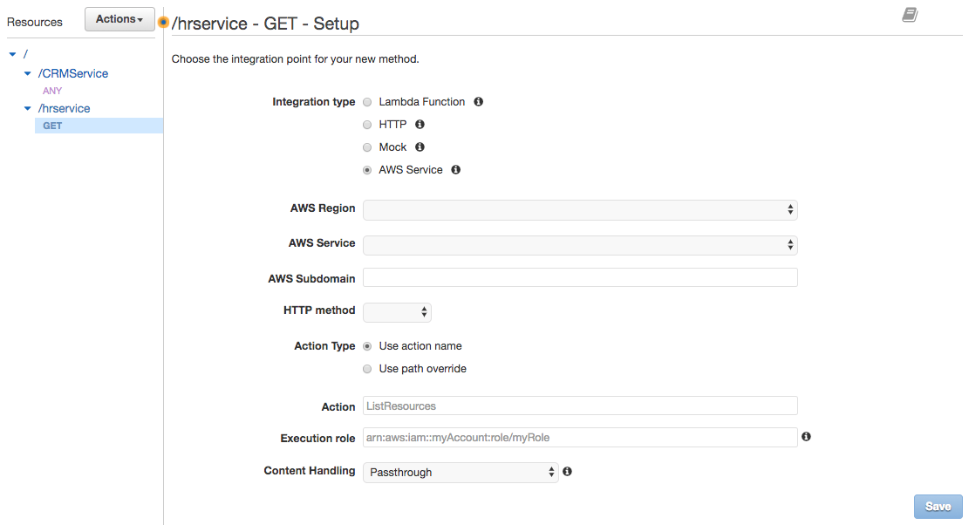
Method

Slide 33
Walkthrough of API
Demo

Slide 34
Step Functions

Slide 35
Workflow Orchestration

Slide 36
Workflow/Orchestration
“A workflow consists of an orchestrated and repeatable pattern of business activity enabled by the systematic organization of resources into processes that transform materials, provide services, or process information.^{[1]} It can be depicted as a sequence of operations, declared as work of a person or group,^{[2]} an organization of staff, or one or more simple or complex mechanisms.” (https://en.wikipedia.org/wiki/Workflow)
“Cloud computing introduces more-granular and specific meanings of the terms "workflows" and "processes" as used in different domains. Processes can be identified at both the level of inter-company business and the level of wide area network ("the cloud") operations. An "orchestrator" is understood to be the entity which manages complex cross-domain (system, enterprise, firewall) processes and handles exceptions. Since an orchestrator is valuable in fulfillment, assurance, and billing processes,^{[4]} service-aware incarnations of an orchestrator should be capable of adjustments based on feedback from monitoring tools. At the most basic level, an orchestrator is a human.” (https://en.wikipedia.org/wiki/Orchestration_(computing))

Slide 37
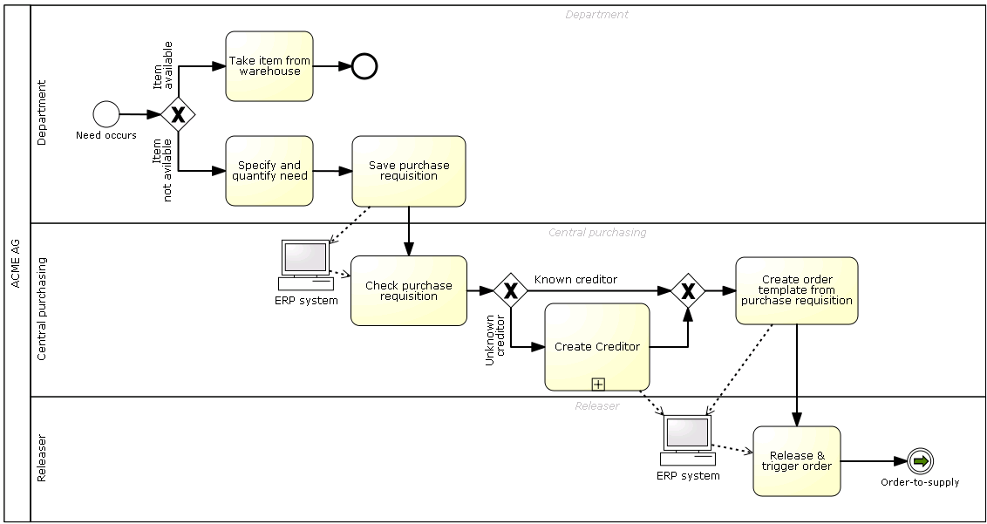
Simple BPMN Diagram

Slide 38
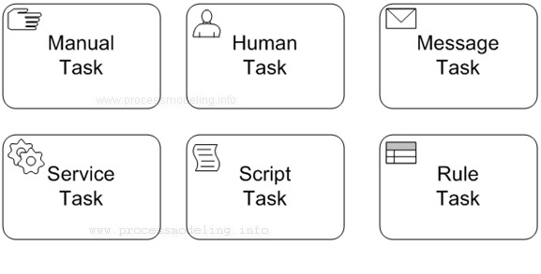
BPMN – How do you Implement?
Send an email.
POST a document
etc.
Notify a person/role.
Have them do something.
Have the use an app that calls the engine to tell you they are done.
Decision table
Call Drools
etc.
Insert into a DB
Call a web service
Run a Java app.
etc.
Run some JavaScript or Java or …
Right at this point in the workflow/process
And manipulate the data/documents/control.

Slide 39
Modeling/Pictures (an aside) https://www.nomagic.com/getting-started/modeling-benefits

Slide 40
Modeling/Pictures (an aside) https://www.nomagic.com/getting-started/modeling-benefits

Slide 41
Step Functions (Introduction)

Slide 42
AWS Step Functions (https://aws.amazon.com/step-functions/)

Slide 43
Execute and Monitor

Slide 44
Simple Example

Slide 45
Simple Example

Slide 46
Concepts

Slide 47
Tasks and Activities

Slide 48
OAuth

Slide 49
Overview (http://tutorials.jenkov.com/oauth2/index.html)
Resource Owner
Controls access to the “data.”
Facebook user, LinkedIn user, …
Resource Server
The website that holds/manages info.
Facebook, LinkedIn, ...
And provides access API.
Client Application
“The product you implemented.”
Wants to read/update
“On your behalf”
The data the data that the Resource Server maintains, e.g. posts, status, tweets, ...
Authorization Server
Grants/rejects authorization
Based on Resource Owner decisions.
Usually (logically) the same as Resource Server.

Slide 50
Roles/Flows
User Clicks “Logon with XXX”
Redirect user to XXX
With Client App application ID.
And permissions app requests.
Code MAY have to call Resource Server to get a token to include in redirect URL.
Browser redirected to XXX
Logon on to XXX prompt.
Followed by “do you grant permission to …”
Clicking button drives a redirect back to Client App. URL contains a temporary token.
User/Browser
Redirected to Client App URL with token.
Client App calls XXX API
Obtains access token.
Returns to User.
Client App can use access token on API calls.

Slide 51
Demo
Facebook application
Test Users
Login/Registration flow
Graph Explorer

